Slide 1
TRANSACTION MANAGEMENT
Transaction:-
A collection of operations that form a single logical atomic unit.
A transaction is a unit of program execution or an executing program that forms a logical unit of database processing I.e., accessing and updating data items.

Slide 2
A transaction includes one or more database access operations – this includes insertion, deletion, updating or retrieval operations.
A transaction can be bounded by putting/specifying the boundaries explicitly by BEGIN TRANSACTION and END TRANSACTION statements in an application program.

Slide 3
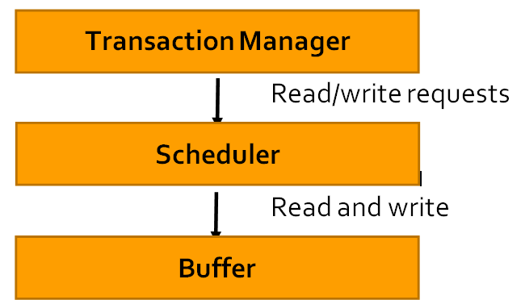
Steps in Executing a Transaction
For a transaction to get executed it must be scheduled and it is the job of the scheduler to schedule and regulate transaction .
The role of scheduler is shown in given diagram :

Slide 4
As soon as a transaction starts to execute , the transaction manager takes the read/write requests and sends it to the scheduler .
The scheduler takes the read/write request from transaction manager and performs the read operation from the buffer or writes the value to the buffer.

Slide 5
read(x)
There are 3 steps when a read function is executed .
They are :
1. Finds the address of the disk block that contains ‘x’.
2. Copies that block into a buffer in main memory .
3. Copies the item x from buffer to program variable named again x ( read(x) )

Slide 6
write(x)
There are 4 steps when a read function is executed .
They are :
1. Finds the address of the disk block that contains ‘x’.
2. Copies that block into a buffer in main memory .
3. Copies item x from program variable named x or t into its correct location in buffer .
4. Store the updated disk block from the buffer back to disk either immediately or at some later point of time .

Slide 7
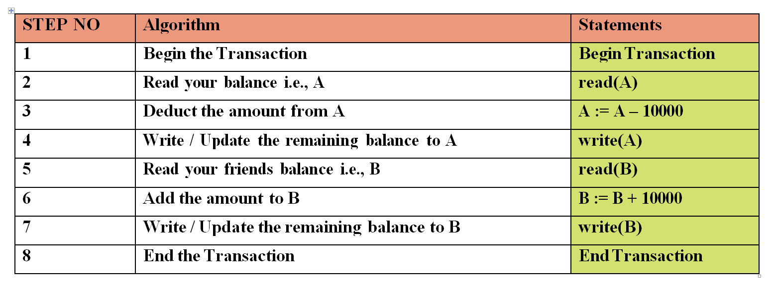
Transaction Example
Let A be your account and your friends account is B .
Write a Transaction to transfer Rs.10000/- from A to B

Slide 8
Before a transaction execution , the transaction must see a consistent database .
During a transaction execution the database may become inconsistent .
When a transaction is committed , the database must be consistent .

Slide 9
Issues that a transaction must deal with :
1. Failures of various kinds , such as hardware failures and system crashes .
2. Concurrent execution of multiple transactions accessing same shared memory .

Slide 10
Properties of Transaction
To deal with the issues that a transaction faces and to maintain the integrity of database during transaction processing we have some concepts/properties of Transactions namely ACID properties
A ­> Atomicity C ­> Consistency I ­> Isolation D ­> Durability

Slide 11
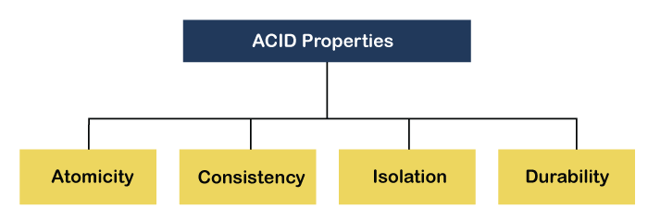

Slide 12
Atomicity ( All or None) :
@ This property states that all of the instructions with in a transaction must be executed or none .
@ If atomicity is present , all actions of transaction are reflected in database or none is reflected .

Slide 13
@ Ensuring atomicity is responsibility of Database System itself , specifically it is handled by the recovery system of transaction management component .
Example explanation :
In previous example ( A ­­­10000­­­> B) , if system crashes at write(A) , then the values are rollbacked / undone . Because of failure , the state of system no longer reflects the values that the database is supposed to capture .( We call it as the inconsistent state) . Therefore the value gets rollbacked to maintain consistency .

Slide 14
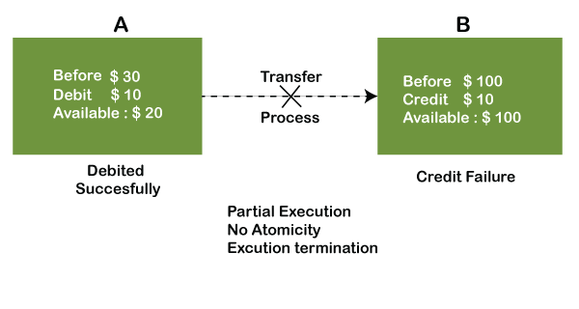
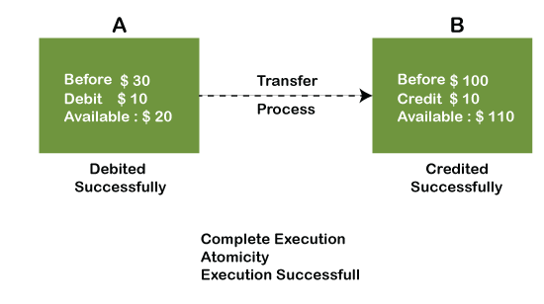

Slide 15
Consistency
@ To maintain integrity , some constraints are maintained so that the database is consistent before and after the transaction .
@ The execution of transaction will leave a database in either of its prior stable state ( old stable db) or its updated new stable state .
@ The consistency property of database states that every transaction sees a consistent Database.
@ Ensuring consistency for an individual transaction is responsibility of an Application programmer who write the code .

Slide 16
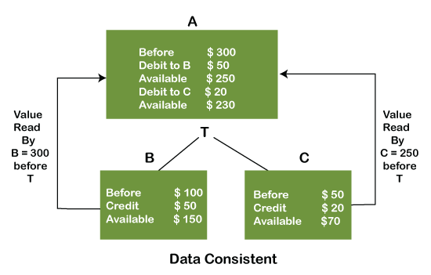

Slide 17
Isolation
It shows that the data which is used at the time of execution of one transaction cannot be used by second transaction until the first one is completed .
@ In isolation if transaction Tk is being executed and using the data item X , then the data item cannot be used by any other transaction Tm until Tk ends .
@ This property ensures that multiple transaction can occur concurrently without leading to inconsistency .
@ Ensuring Isolation is the responsibility of concurrency sub system .

Slide 18
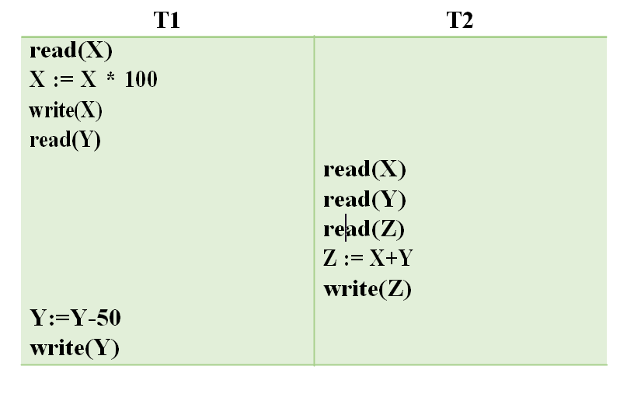
Example :
Consider the following transactions X = 50 Y = 60

Slide 19
In the above transactions if T2 executes at the specified position then the value of Z becomes 5060 and if T2 executes after finishing of T1 then Z becomes 5010 .
Therefore , from isolation we can say that no 2 transactions can execute on same shared memory at a same time .
If executed also it is ok till there is no inconsistency occurs.

Slide 20
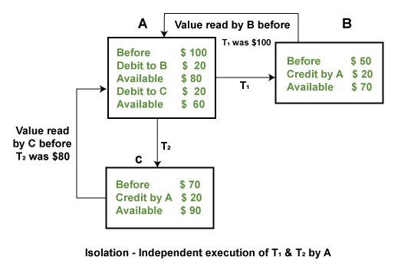

Slide 21
Durability
@ This property says that once after the transaction is completed the changes that has been made must be permanent and should be recoverable even after system crashes and power failures .
or
@ This property ensures that , once the transaction has completed execution , the updates to the database are stored in and written in disk and they persist even if failure occurs .
@ Ensuring the durability is responsibility of recovery subsystem .

Slide 22
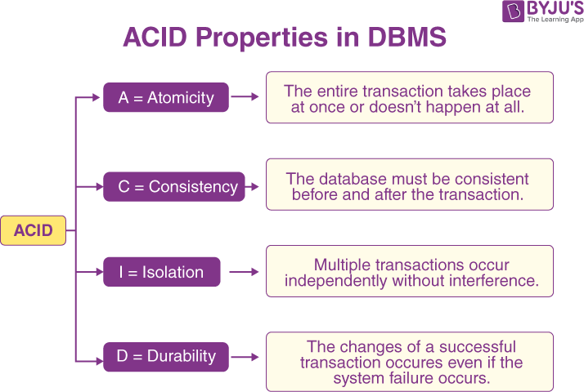

Slide 23
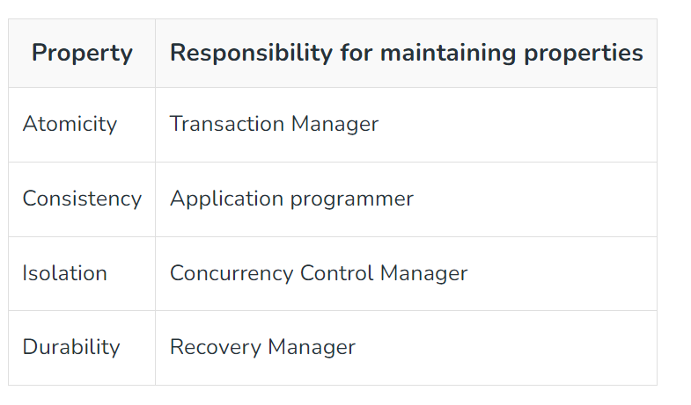

Slide 24
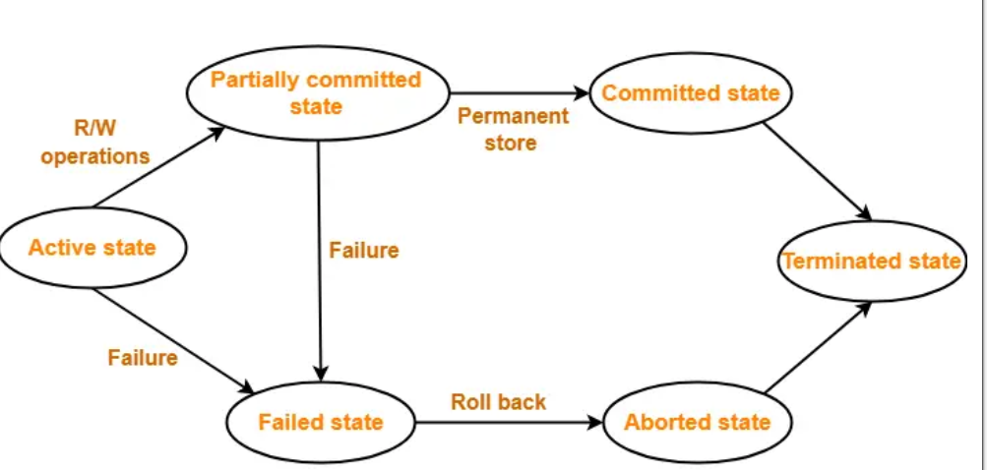
TRANSACTION STATES

Slide 25
Active :
1st state of every transaction .
In this state the transaction will start being executed and get executed till the last line of transaction.
Partially committed : This is an execution state where the last step of transaction is executed.
Last line can have 2 statements :
1. commit : This signals a successful end of transaction so that any changes made while executing an transactions are now updated permanently in database.
2. rollback : This signals an unsuccessful end of transaction so that any changes made while executing a transaction are now need get undone and have the prior stable state .

Slide 26
Committed : In this state the transactions are permanently saved to Database .
Failed :When a transaction is getting executed in the active state or partially committed state and some failure occurs due to which it becomes impossible to continue the execution, it enters into a failed state.
Aborted : After the transaction has failed and entered into a failed state, all the changes made by it have to be undone.
To undo the changes made by the transaction, it becomes necessary to roll back the transaction.
After the transaction has rolled back completely, it enters into an aborted state.

Slide 27
Terminated :This is the last state in the life cycle of a transaction.
After entering the committed state or aborted state, the transaction finally enters into a terminated state where its life cycle finally comes to an end.
A transaction execution starts in active state .
When it comes near final statement it enters to partially committed state where the last statement will be executed.
At this point , the transaction has completed its execution , but it is still possible that it may have to be aborted due to rollback statement or system failure or some exceptions .
If there are no crashes then transaction moves to committed state where the value updates are made permanent .

Slide 28
Implementation of Atomicity and Durability
Basically , it’s the responsibility of the recovery system to maintain or implement the atomicity and durability through various schemes .
There are many schemes through which atomicity as well durability is implemented . 2 of them are :
1. Implementing shadow copy scheme
2. Log – based recovery .
How can we guarantee atomicity and durability ?
Atomicity is guaranteed by undoing the actions of the transactions that did not commit (aborted).
Durability is guaranteed by making sure that all actions of committed transactions survive crashes and failures.

Slide 29
Shadow copy scheme
This scheme assumes that there is only one transaction at a time .
This scheme assumes the database to be a single file or location on disk In shadow copy scheme , a transaction that wants to update the database first creates a complete copy of database .
All updates are done on new database copy , leaving the original copy which is shadow copy untouched .

Slide 30
If at any point the transaction has to be aborted , the system merely deletes the new copy . The old copy of database has not been affected .
This scheme is based on making copies of database , called shadow copy assuming only one transaction is active at a time .
A pointer called the db_pointer is maintained on disk , it points to current copy of data base .
There are 2 cases i.e., transaction may complete or abort .

Slide 31
Shadow copy scheme ­> If transaction is committed .
First , the operating system is asked to make sure that all pages of new copy of database have been written out to disk .
After the operating system has written all the pages to disk , the database system updates the pointer to point the new copy of database , the new copy becomes the current copy of database .
The old copy of database is then deleted .
Make the db_pointer to point to the old copy and just delete the new updated copy .

Slide 32
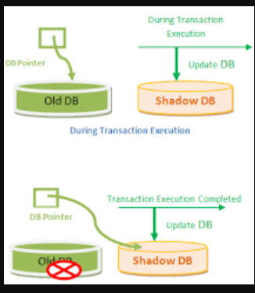

Slide 33
Concurrency and Its problems
Concurrency refers to executing more than one instruction while other transactions are being executed .
If transactions are executed concurrently as they wish , there may be some of the problems that araises.
They are :
1. Lost Update problem
2. Dirty Read Problem
3. Incorrect summary
4. Unrepeatable reads

Slide 34
Lost Update problem W - W Conflict
The values that are updated by one transaction is overridden by other transaction.
The value that is updated by one transaction is lost , hence called as lost update problem .Ex :

Slide 35
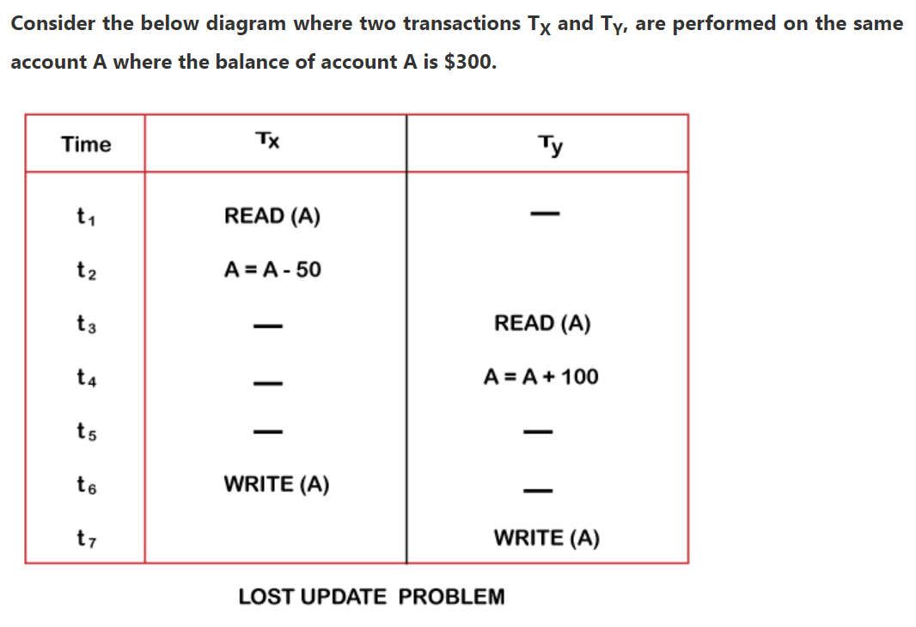

Slide 36
At time t1, transaction T_{X} reads the value of account A, i.e., $300 (only read).
At time t2, transaction T_{X} deducts $50 from account A that becomes $250 (only deducted and not updated/write).
Alternately, at time t3, transaction T_{Y} reads the value of account A that will be $300 only because T_{X} didn't update the value yet.

Slide 37
At time t4, transaction T_{Y} adds $100 to account A that becomes $400 (only added but not updated/write).
At time t6, transaction T_{X} writes the value of account A that will be updated as $250 only, as T_{Y} didn't update the value yet.
Similarly, at time t7, transaction T_{Y} writes the values of account A, so it will write as done at time t4 that will be $400. It means the value written by T_{X} is lost, i.e., $250 is lost.
Hence data becomes incorrect, and database sets to inconsistent.

Slide 38
Dirty Read Problems (W-R Conflict)
This problem occurs when a variable reads the value that is dirty ( unwanted ).
This problem occurs when one transaction updates the database and the transaction gets aborted due to some failures , in the mean time other transaction accesses the updated item .
But as the transaction is failed , the transaction undo the old values to the database , but the other transaction has read the updated value which is dirty .

Slide 39
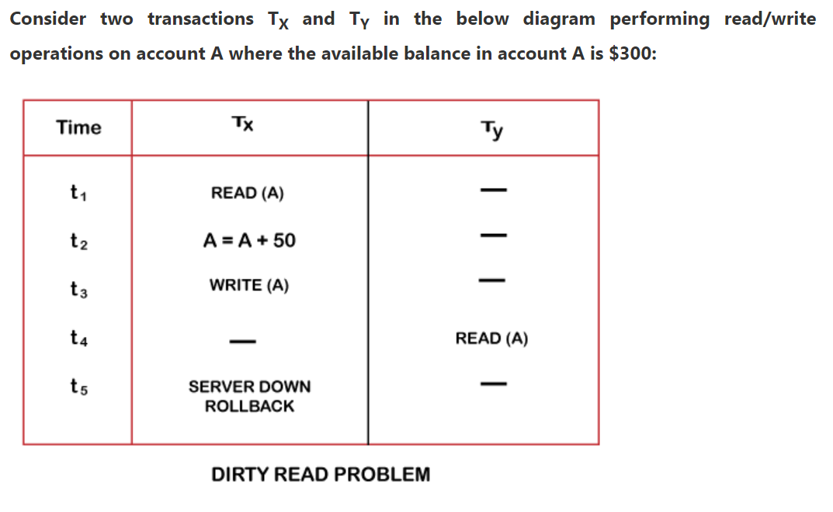

Slide 40
At time t1, transaction T_{X} reads the value of account A, i.e., $300.
At time t2, transaction T_{X} adds $50 to account A that becomes $350.
At time t3, transaction T_{X} writes the updated value in account A, i.e., $350.

Slide 41
Then at time t4, transaction T_{Y} reads account A that will be read as $350.
Then at time t5, transaction T_{X} rollbacks due to server problem, and the value changes back to $300 (as initially).
But the value for account A remains $350 for transaction T_{Y} as committed, which is the dirty read and therefore known as the Dirty Read Problem.

Slide 42
Concurrency and Its problems­ INCORRECT SUMMARY
This problem is caused when one of the transactions is executing an aggregate operation on several data items, and other transactions are updating one or more of those data items.
This causes a inconsistent database state.

Slide 43
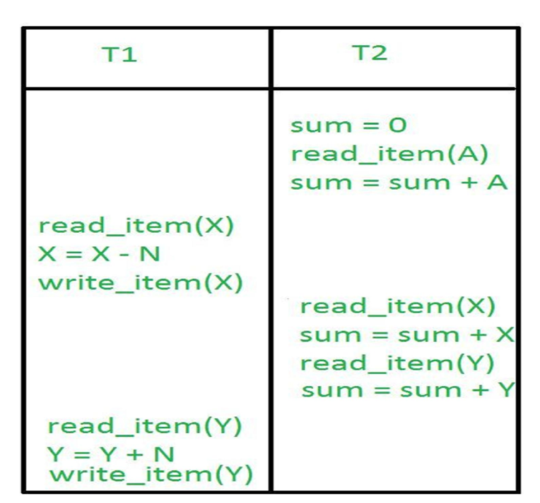

Slide 44
Concurrency and Its problems­ UNREPEATABLE READs
This problem occurs when a transaction gets to read unrepeated i.e. different values of the same variable in its different read operations even when it has not updated its value.

Slide 45
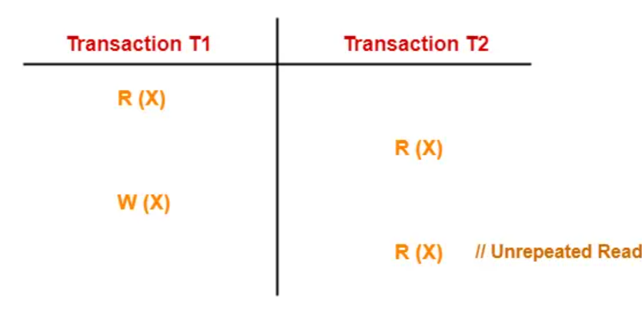

Slide 46
Here,
T1 reads the value of X (= 10 say).
T2 reads the value of X (= 10).
T1 updates the value of X (from 10 to 15 say) in the buffer.
T2 again reads the value of X (but = 15).
In this example,
T2 gets to read a different value of X in its second reading.
T2 wonders how the value of X got changed because according to it, it is running in isolation.

Slide 47
Schedules in DBMS-
The order in which the operations of multiple transactions appear for execution is called as a schedule.
  A schedule for a set of transactions must consist of all instructions of those transactions
  must preserve the order in which the instructions appear in each individual transaction.

Slide 48
A transaction that successfully completes its execution will have a commit instructions as the last statement by default transaction assumed to execute commit instruction as its last step.
A transaction that fails to successfully complete its execution will have an abort instruction as the last statement

Slide 49

Schedule 1
Let T₁ transfer $50 from A to B

Slide 50
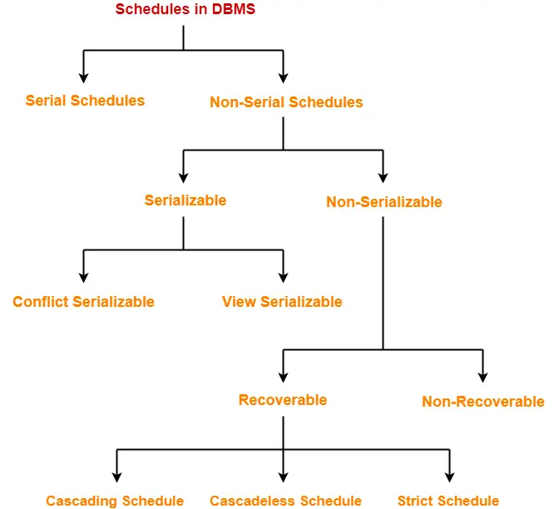

Slide 51
Serial Schedules-
In serial schedules,
All the transactions execute serially one after the other.
When one transaction executes, no other transaction is allowed to execute. Schedule S is called serial schedule if all the transactions execute one after other serially i.e.,
if one transaction is being executed then other transactions must stay idle .

Slide 52
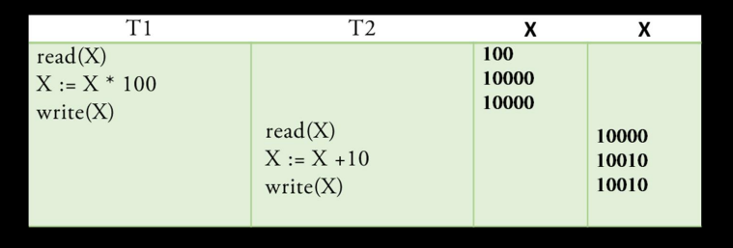

Slide 53
Even T1 after T2 is also a Serial Transaction .
Here as there are no interleaved actions , serial schedules are also called as Non ­interleaved schedules
Advantage :
It always leads to consistency
Disadvantages of Serial Schedules: High average waiting time.

Slide 54
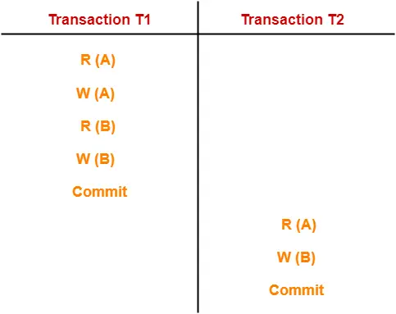
In this schedule,
There are two transactions T1 and T2 executing serially one after the other.
Transaction T1 executes first.
After T1 completes its execution, transaction T2 executes.
So, this schedule is an example of a Serial Schedule.

Slide 55
Schedule 1
Let T₁ transfer $50 from A to B, and T₂ transfer 10% of the balance from A to B.
A serial schedule in which T₁ is followed by T₂ :

Slide 56

Schedule 2
A serial schedule where T₂ is followed by T₁

Slide 57
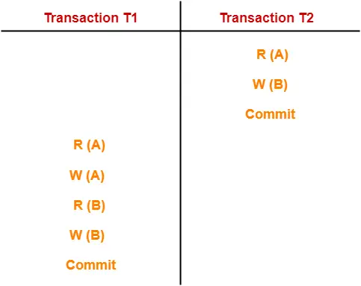
In this schedule,
There are two transactions T1 and T2 executing serially one after the other.
Transaction T2 executes first.
After T2 completes its execution, transaction T1 executes.
So, this schedule is an example of a Serial Schedule.

Slide 58

Schedule 3
Let T₁ and T₂ be the transactions defined previously. The following schedule is not a serial schedule, but it is equivalent to Schedule 1.

Slide 59
Non-Serial Schedules-
In non-serial schedules,
Multiple transactions execute concurrently.
Operations of all the transactions are inter leaved or mixed with each other.

Slide 60
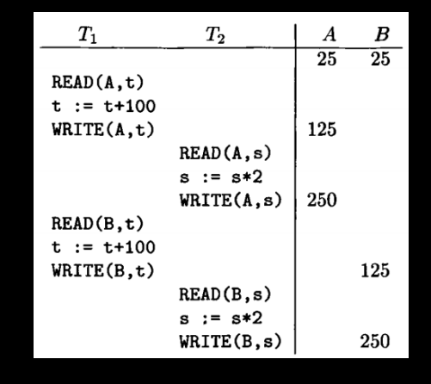

Slide 61
In this schedule,
There are two transactions T1 and T2 executing concurrently.
The operations of T1 and T2 are interleaved.
So, this schedule is an example of a Non-Serial Schedule.

Slide 62
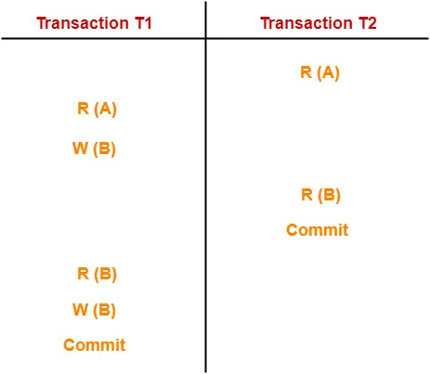
In this schedule,
There are two transactions T1 and T2 executing concurrently.
The operations of T1 and T2 are interleaved.
So, this schedule is an example of a Non-Serial Schedule.

Slide 63
Serializability:-
Each transaction preserves database consistency.
Thus serial execution of a set of transactions preserves database consistency.
A (possibly concurrent) schedule is serializable if it is equivalent to a serial schedule.

Slide 64
A serial schedule is always a serializable schedule because in serial schedule, a transaction only starts when the other transaction finished execution.
However a non-serial schedule needs to be checked for Serializability.

Slide 65
A non-serial schedule of n number of transactions is said to be serializable schedule, if it is equivalent to the serial schedule of those n transactions.
A serial schedule doesn’t allow concurrency, only one transaction executes at a time and the other starts when the already running transaction finished.

Slide 66
Types of Serializability
There are two types of Serializability.
1. Conflict Serializability
2. View Serializability

Slide 67
Conflict Serializability is one of the type of Serializability, which can be used to check whether a non-serial schedule is conflict serializable or not.

Slide 68
A schedule is called conflict serializable if we can convert it into a serial schedule after swapping its non-conflicting operations.

Slide 69
Conflicting operations
Two operations are said to be in conflict, if they satisfy all the following three conditions:
1. Both the operations should belong to different transactions.
2. Both the operations are working on same data item.
3. At least one of the operation is a write operation.

Slide 70
Example 1:
Operation W(X) of transaction T1 and operation R(X) of transaction T2 are conflicting operations, because they satisfy all the three conditions mentioned above.
They belong to different transactions, they are working on same data item X, one of the operation in write operation.

Slide 71
Example 2: Similarly Operations W(X) of T1 and W(X) of T2 are conflicting operations.
Example 3: Operations W(X) of T1 and W(Y) of T2 are non-conflicting operations because both the write operations are not working on same data item so these operations don’t satisfy the second condition.

Slide 72
Example 4: Similarly R(X) of T1 and R(X) of T2 are non-conflicting operations because none of them is write operation.
Example 5: Similarly W(X) of T1 and R(X) of T1 are non-conflicting operations because both the operations belong to same transaction T1.

Slide 73
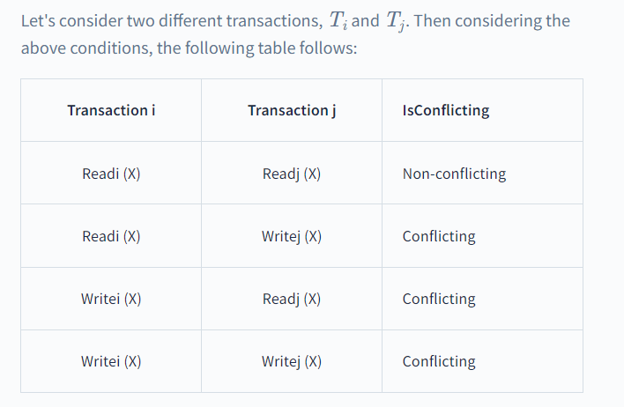

Slide 74
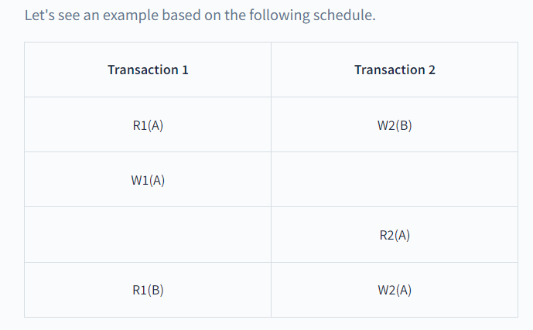

Slide 75
In the above schedule, we can notice that:
W1(A) and R2(A) are part of different transactions.
Both apply to the same data item, i.e., A.
W1(A) is a write operation.
W1(A) and R2(A) are conflicting operations as they satisfy all the above conditions.
Similarly, W1(A) and W2(A) are conflicting operations as they are part of different transactions working on the same data item, and one of them is the write operation.

Slide 76
W1(A) and W2(B) are non-conflicting operations as they work on different data items and thus do not satisfy all the given conditions.
R1(A) and R2(A) are non-conflicting operations as none of them is a write operation and thus does not satisfy the third condition.
W1(A) and R1(A) are non-conflicting as they belong to the same transactions and thus do not satisfy the first condition.

Slide 77
Conflict Equivalent Schedules
Two schedules are said to be conflict Equivalent if one schedule can be converted into other schedule after swapping non-conflicting operations.

Slide 78
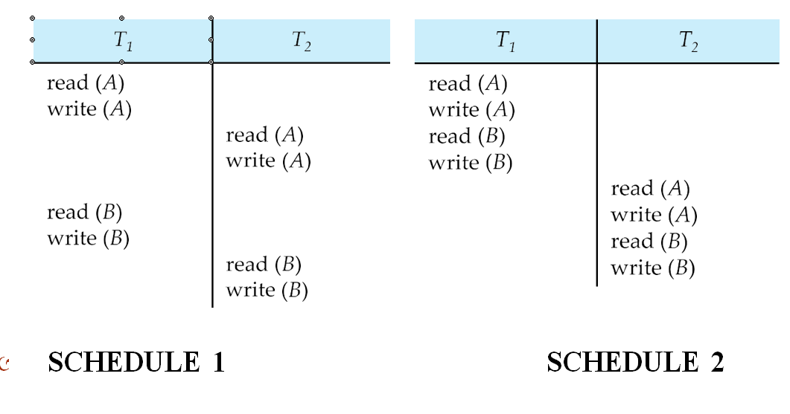
Schedule 1 can be transformed into Schedule 2, a serial schedule
where T₂ follows T₁, by series of swaps of non-conflicting
instructions.
Therefore Schedule 1 is conflict serializable.

Slide 79
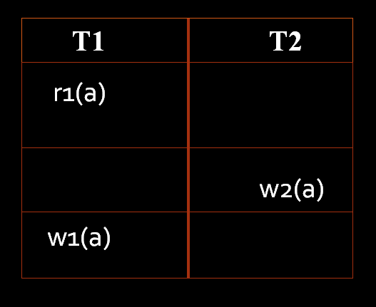
Check whether the following is conflict serializable or not ?

Slide 80
Testing for Conflict Serializability
Create a precedence graph for the schedule
Directed graph where each transaction is a vertex
An edge from transaction Ti to Tj exists if
  w_{i}(x) precedes r_{j}(x), or
  r_{i}(x) precedes w_{j}(x), or
  w_{i}(x) precedes w_{j}(x)
A schedule is conflict serializable if and only if its precedence graph is acyclic.

Slide 81
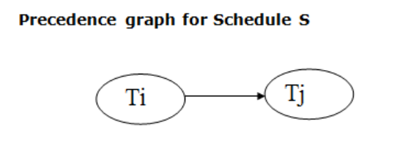
If a precedence graph contains a single edge Ti → Tj, then all the instructions of Ti are executed before the first instruction of Tj is executed.
If a precedence graph for schedule S contains a cycle, then S is non-serializable. If the precedence graph has no cycle, then S is known as serializable.

Slide 82
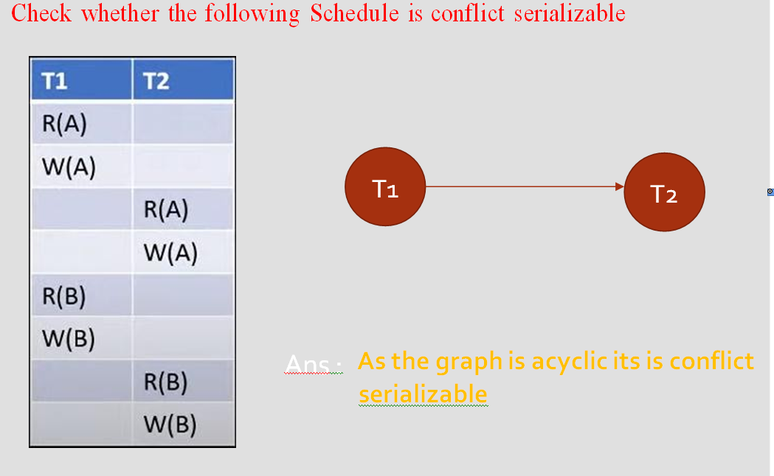

Slide 83
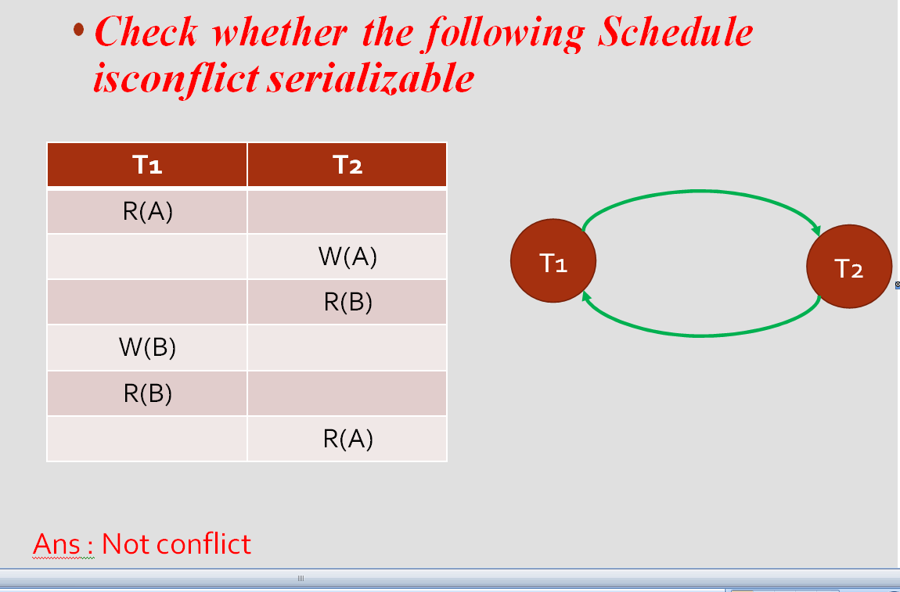

Slide 84
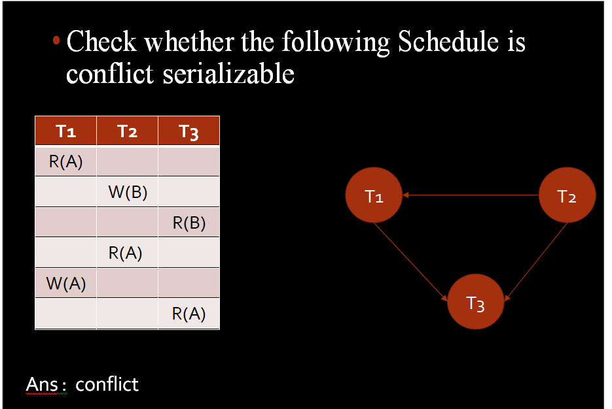

Slide 85
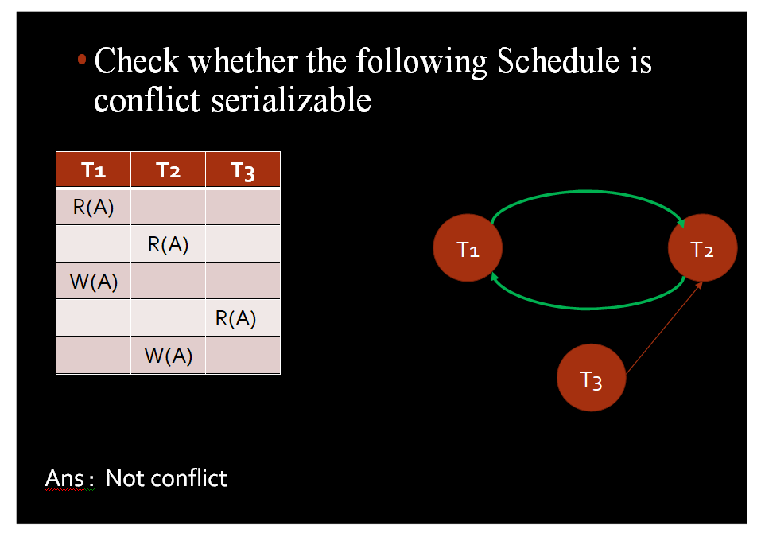

Slide 86
Check whether a schedule is conflict serializable or not.
T1 | T2 | T3
R(X)
 |  | R(Y)
 |  | R(X)
 | R(Y)
 | R(Z)
 |  | W(Y)
 | W(Z)
R(Z)
W(X)
W(Z)

Slide 87
T1
T3
T1-T2-T3
T1-T3-T2
T2-T3-T1
T2-T1-T3
T3-T2-T1
T3-T1-T2
INDEGREE FOR THE TREE NODES
T2

Slide 88
Checking Whether a Schedule is Conflict Serializable Or Not-
Follow the following steps to check whether a given non-serial schedule is conflict serializable or not-
Step-01:
Find and list all the conflicting operations.
Step-02:
Start creating a precedence graph by drawing one node for each transaction.

Slide 89
Step-03:
Draw an edge for each conflict pair such that if X_{i} (V) and Y_{j} (V) forms a conflict pair then draw an edge from T_{i} to T_{j}.
This ensures that T_{i} gets executed before T_{j}.
Step-04:
Check if there is any cycle formed in the graph.
If there is no cycle found, then the schedule is conflict serializable otherwise not.

Slide 90
PRACTICE PROBLEMS BASED ON CONFLICT SERIALIZABILITY-
Problem-01:
Check whether the given schedule S is conflict serializable or not-
S : R₁(A) , R₂(A) , R₁(B) , R₂(B) , R₃(B) , W₁(A) , W₂(B)

Slide 91
Step-01:
List all the conflicting operations and determine the dependency between the transactions-
R₂(A) , W₁(A) (T₂ → T₁)
R₁(B) , W₂(B) (T₁ → T₂)
R₃(B) , W₂(B) (T₃ → T₂)

Slide 92
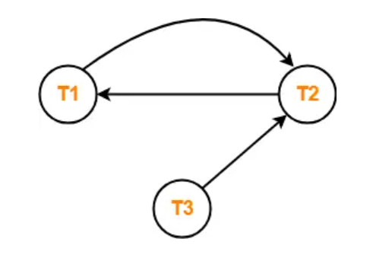
Step-02:
Draw the precedence graph-
Clearly, there exists a cycle in the precedence graph.
Therefore, the given schedule S is not conflict serializable.

Slide 93
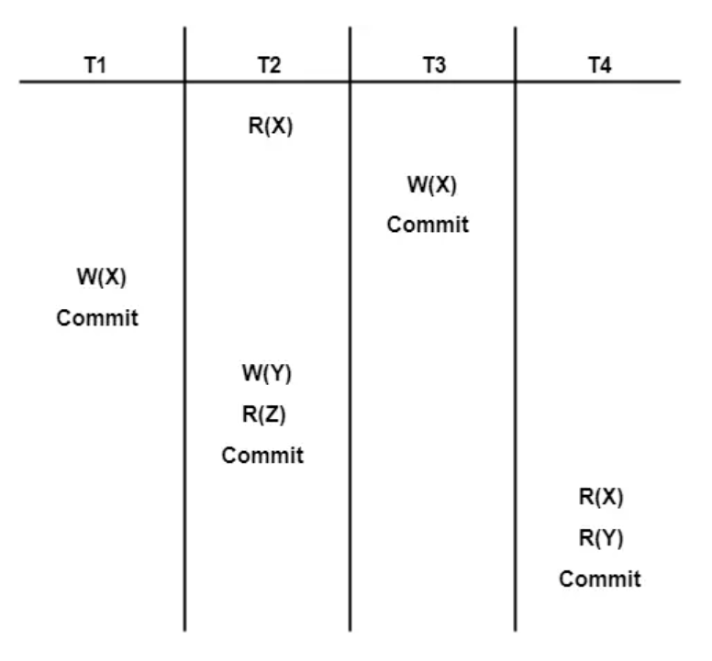
Problem-02:
Check whether the given schedule S is conflict serializable or not-

Slide 94
Step-01:
List all the conflicting operations and determine the dependency between the transactions-
R₂(X) , W₃(X) (T₂ → T₃)
R₂(X) , W₁(X) (T₂ → T₁)
W₃(X) , W₁(X) (T₃ → T₁)
W₃(X) , R₄(X) (T₃ → T₄)
W₁(X) , R₄(X) (T₁ → T₄)
W₂(Y) , R₄(Y) (T₂ → T₄)

Slide 95
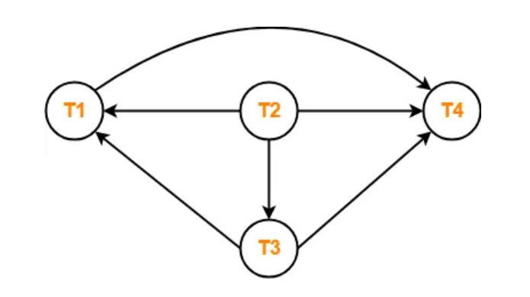
Step-02:
Draw the precedence graph-
Clearly, there exists no cycle in the precedence graph.
Therefore, the given schedule S is conflict serializable.

Slide 96
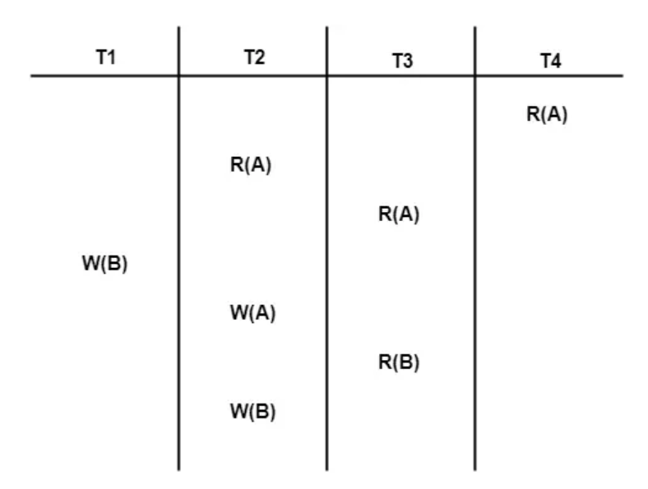
Problem-03:
Check whether the given schedule S is conflict serializable or not.

Slide 97
Step-01:
List all the conflicting operations and determine the dependency between the transactions-
R₄(A) , W₂(A) (T₄ → T₂)
R₃(A) , W₂(A) (T₃ → T₂)
W₁(B) , R₃(B) (T₁ → T₃)
W₁(B) , W₂(B) (T₁ → T₂)
R₃(B) , W₂(B) (T₃ → T₂)

Slide 98
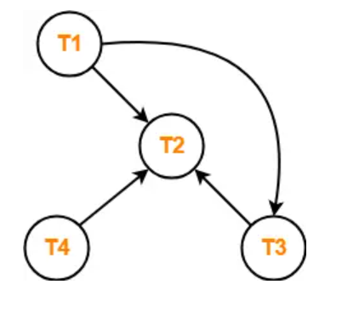
Step-02:
Draw the precedence graph-Clearly, there exists no cycle in the precedence graph.
Therefore, the given schedule S is conflict serializable.

Slide 99
View Serializability
View Serializability is a process to find out that a given schedule is view serializable or not.
To check whether a given schedule is view serializable, we need to check whether the given schedule is View Equivalent to its serial schedule.

Slide 100
A schedule S is view serializable if it is view equivalent to a serial schedule
  Formally, two schedules S and S’ are view equivalent if For each data item x
Ti reads the initial value of x in S, it reads the same initial value of x in S’ as well
Ti writes the final value of x in S,it writes the final value of a in S’ as well
If transaction Ti reads the value of data item x produced by write action of transaction Tj in S, it must read the value written by Tj in S’ as well.

Slide 101
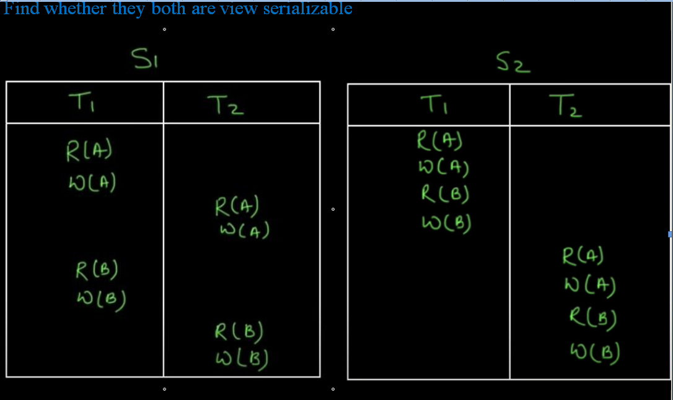

Slide 102
Yes (Because the read on object A is done 1st by T1 in both and final write is done by T2 in both and same with B and also the order of read writes of different transactions are not changed )

Slide 103
All conflict serializable schedules are view serializable.
For those schedule that are not conflict serializable.
  If there does not exist any blind write, then the schedule is surely not view serializable.
  If there exists any blind write, then the schedule may or may not be view serializable.

Slide 104
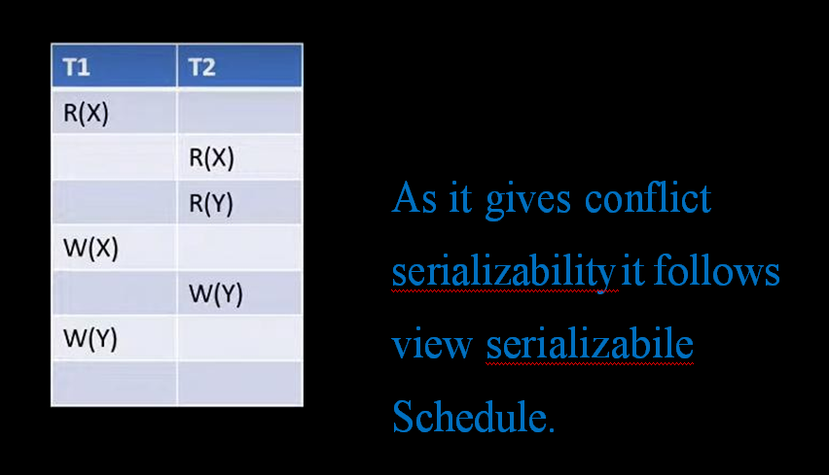

Slide 105
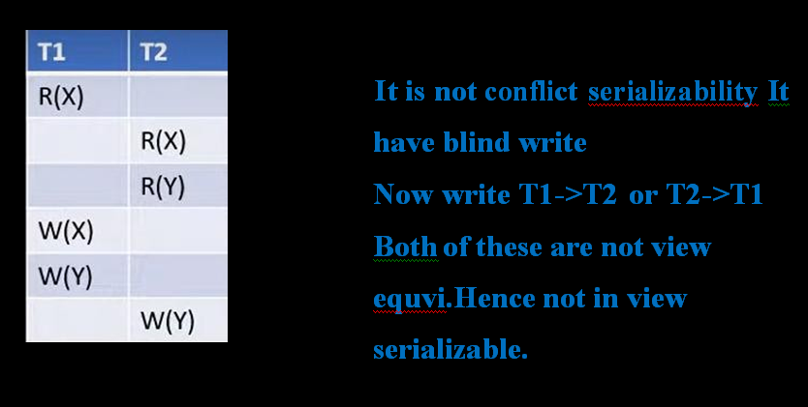

Slide 106
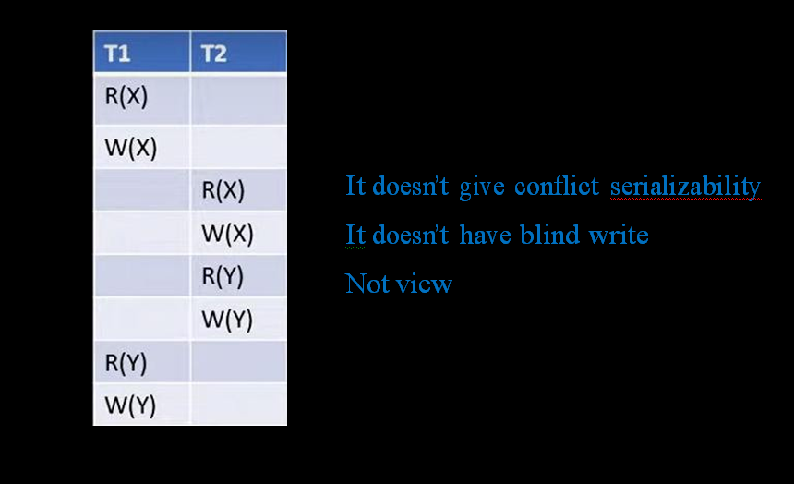

Slide 107
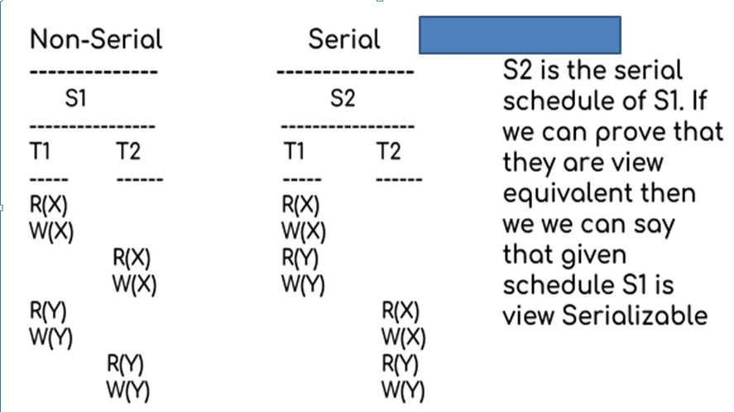
Lets take an example.

Slide 108
Lets check the three conditions of view serializability:
In schedule S1, transaction T1 first reads the data item X.
In S2 also transaction T1 first reads the data item X.

Slide 109
Lets check for Y. In schedule S1, transaction T1 first reads the data item Y.
In S2 also the first read operation on Y is performed by T1.
We checked for both data items X & Y and the initial read condition is satisfied in S1 & S2.

Slide 110
Lets check for X.
In schedule S1, the final write operation on X is done by transaction T2.
In S2 also transaction T2 performs the final write on X.

Slide 111
Lets check for Y.
In schedule S1, the final write operation on Y is done by transaction T2.
In schedule S2, final write on Y is done by T2.
We checked for both data items X & Y and the final write condition is satisfied in S1 & S2.

Slide 112
In S1, transaction T2 reads the value of X, written by T1.
In S2, the same transaction T2 reads the X after it is written by T1.
In S1, transaction T2 reads the value of Y, written by T1.
In S2, the same transaction T2 reads the value of Y after it is updated by T1.
The update read condition is also satisfied for both the schedules.

Slide 113
Since all the three conditions that checks whether the two schedules are view equivalent are satisfied in this example, which means S1 and S2 are view equivalent.
Also, as we know that the schedule S2 is the serial schedule of S1, thus we can say that the schedule S1 is view serializable schedule.

Slide 114
PRACTICE PROBLEMS BASED ON VIEW SERIALIZABILITY-
Problem-01:
Check whether the given schedule S is view serializable or not-

Slide 115
If the given schedule is not conflict serializable, then it may or may not be view serializable. Go and check using other methods.

